Slide 1
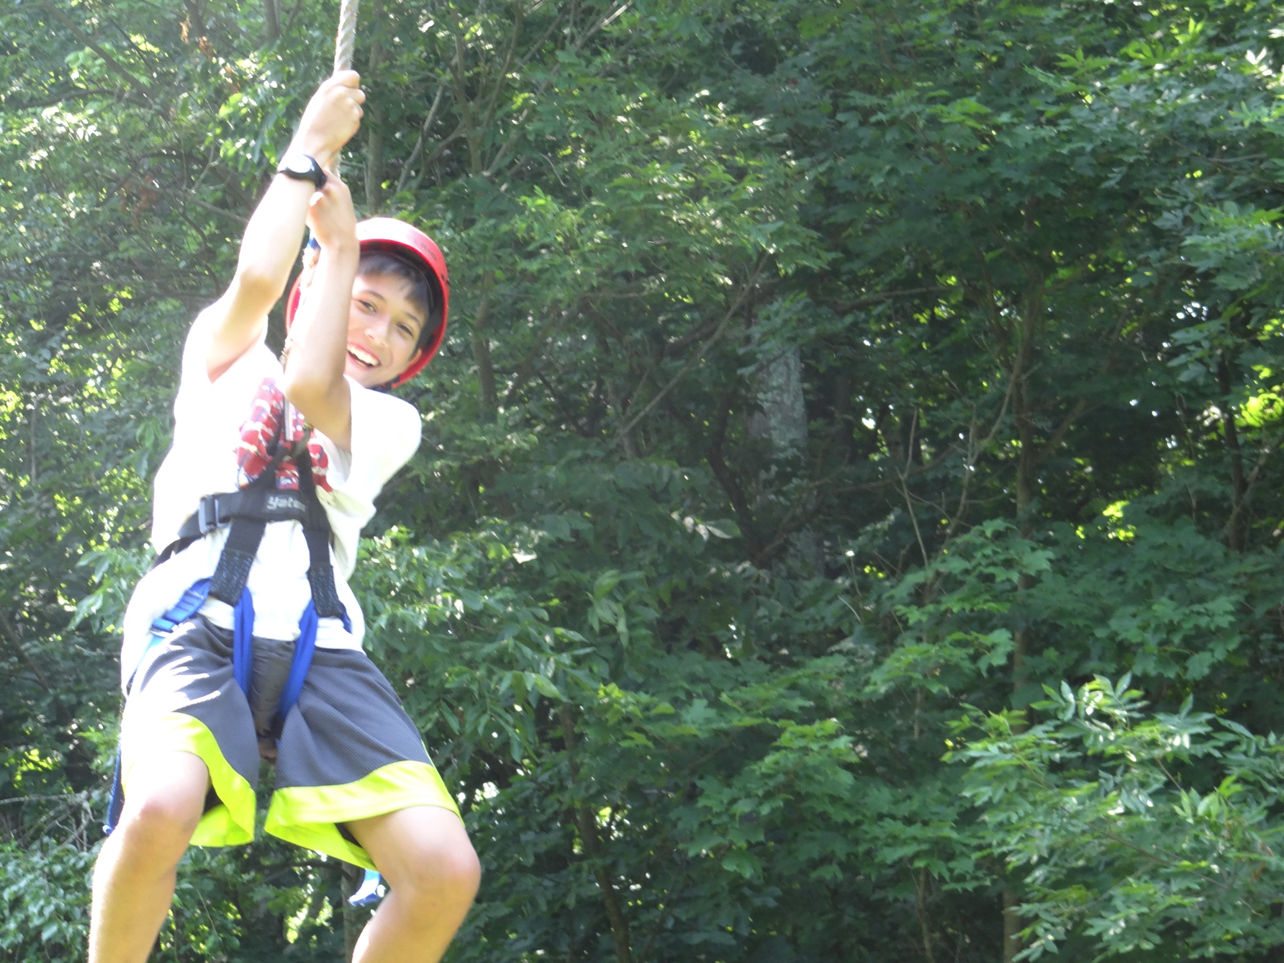
Notes:
Give Andrew and Drew’s stories about going to camp as kids

Slide 2
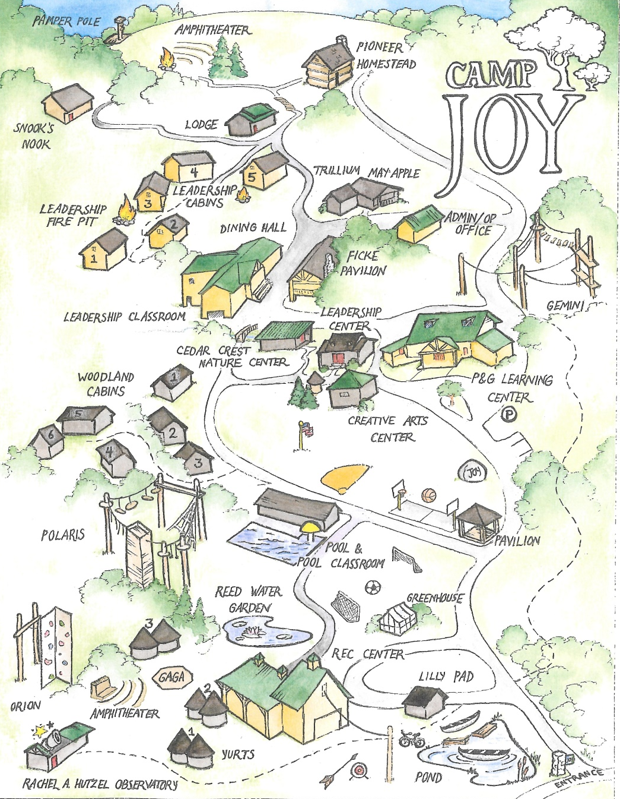
Background
Founded in 1938 by St. Barnabus Episcopal Church
Moved around several times before settling in Clarkesville, Ohio
317 acre location finally large enough to support new initiatives
Notes:
Location & campus

Slide 3
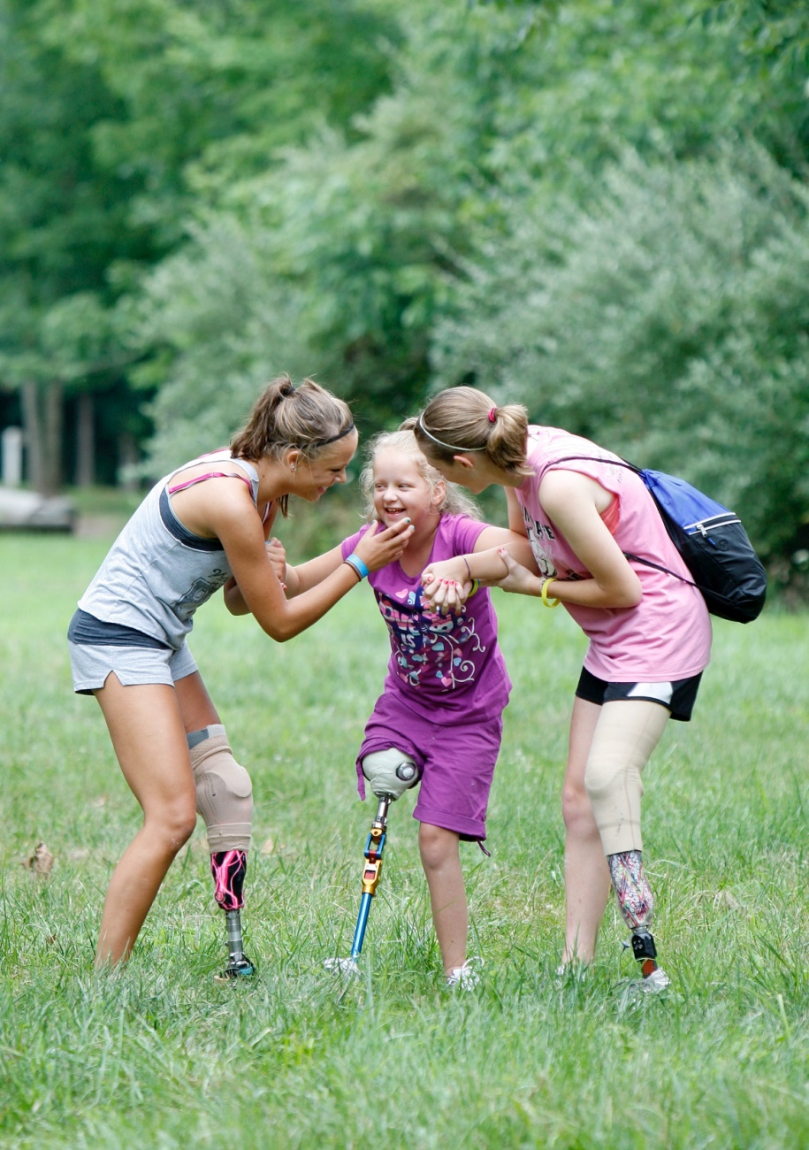
Why Camp Joy?
Focus on underserved
populations
Partnership with Cincinnati Children’s
Outreach to foster homes and agencies like the Boys & Girls Clubs of America
Notes:
Why we chose camp joy – educating about climate change, especially underserved youth

Slide 4
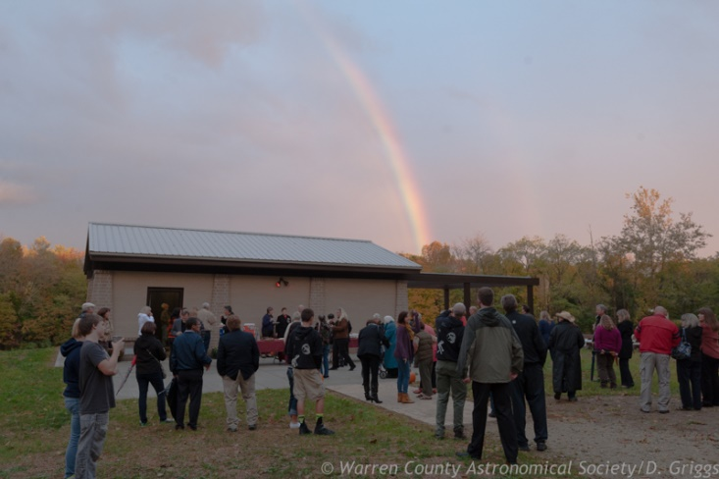
Accomplishments
Camp Joy won the Better Business Bureau’s Torch Award for Business Ethics in 2008
Recently celebrated 75 years of service in 2013 by exceeding their fundraising goal of $2 million
Cincinnati USA Regional Chamber’s Nonprofit Organization of the Year (2013)
In the fall of 2014, Camp Joy opened the Rachel A. Hutzel Observatory after 3 years of planning & construction
Notes:
Recent accomplishments by the organization

Slide 5
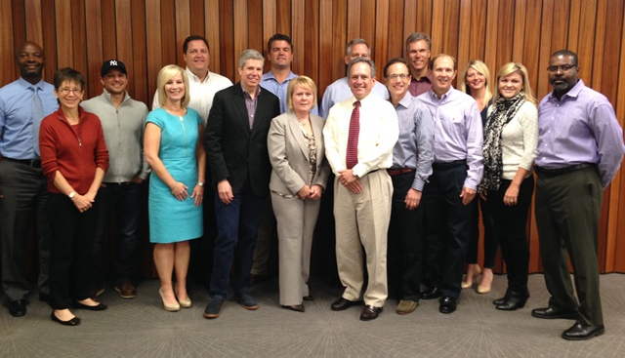
Board of Directors
The People
Representatives from Cincinnati Children’s, Fifth Third Bank, E.W. Scripps Company and others
Grandfathering-in system to maintain diversity and connections
Notes:
Many relationships with other organizations from the city

Slide 6
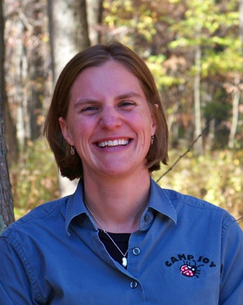
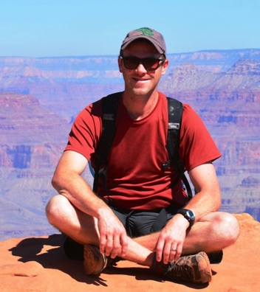
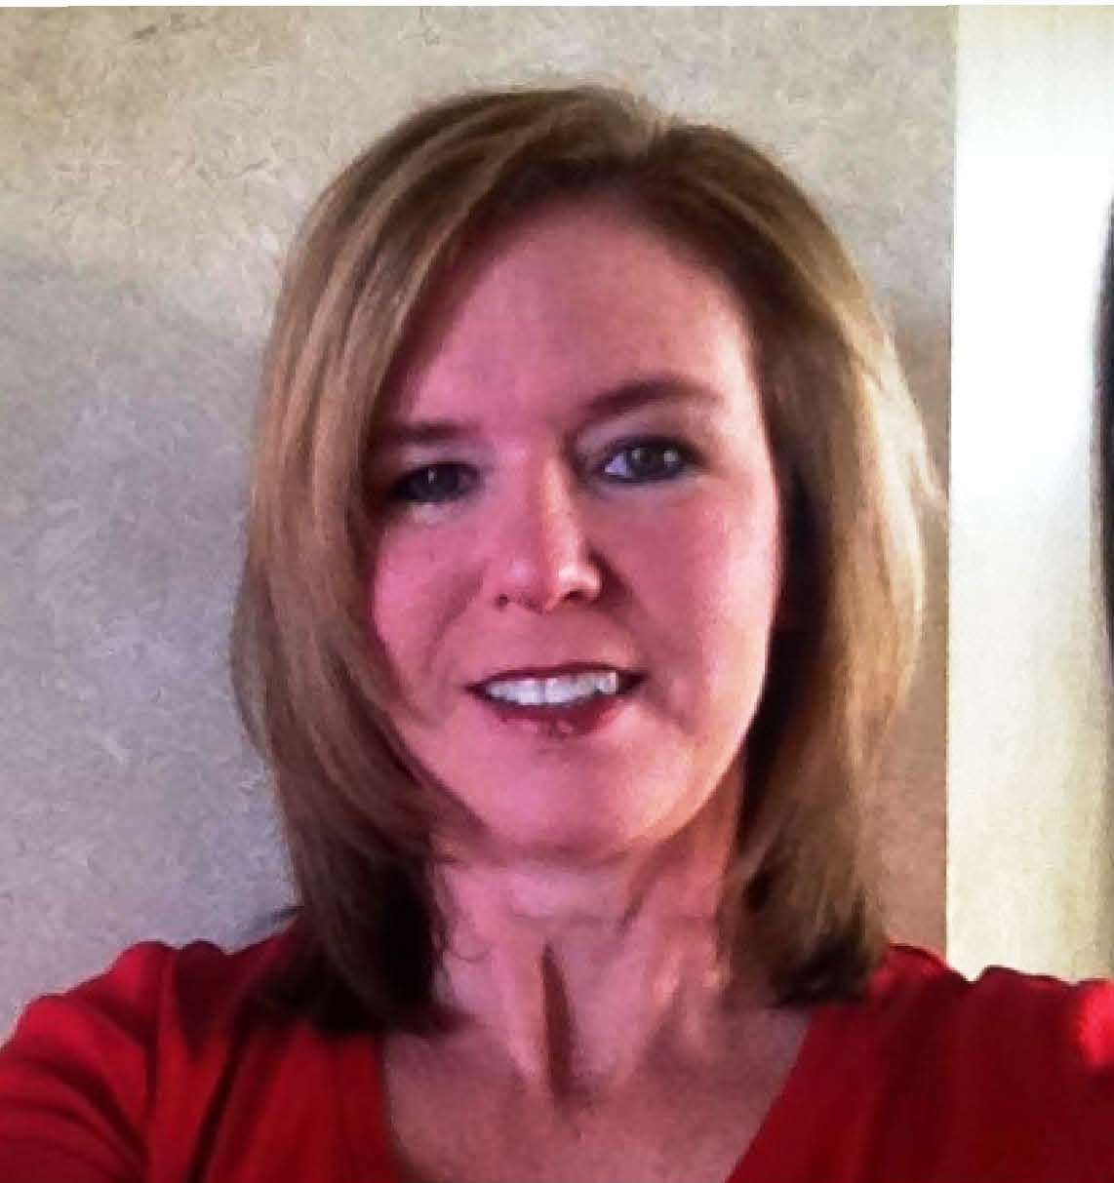
Executive Staff
The People
Michelle Slocum
Finance Director
Amy Thompson
Executive Director
Kevin Hackman
Marketing Director
Notes:
We spoke with Kevin when we visited…

Slide 7
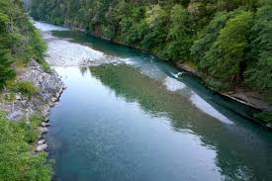
Camp Joy is green!
Dining hall newly
renovated for energy
efficiency
D.I.R.T. reports and composting initiative
Water treatment facility
on site
Selective harvesting
fosters higher rates of
CO2 absorption
Notes:
Some initiatives they are focusing on right now

Slide 8
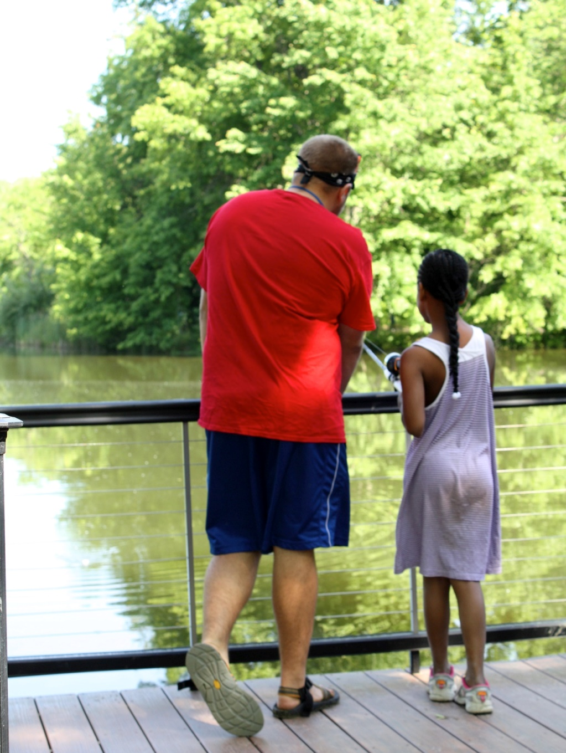
Outdoor Education
Diverse menu of pro-
grams tailor fit to school
curriculum
Ever-changing Earth
Rocks and Minerals
Garbology
Wetland Ecology
Forest Ecology
Notes:
How they teach the children that come to Camp Joy

Slide 9
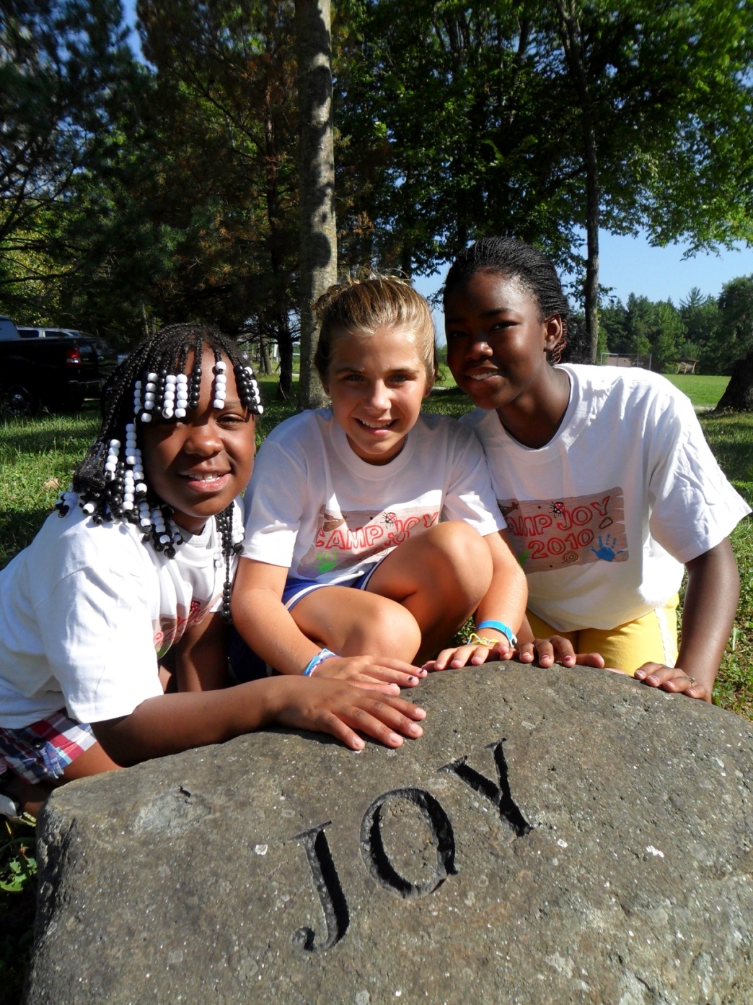
A Holistic Approach
Leadership training
Group Initiatives
Notes:
Not just education though, they have many camps for all types of kids and situations

Slide 10
Fiscal Responsibility
Revenue: $4.2 M
Expenses: $3.3 M
89% programing
11% Administrative costs
Students pay $40
Scholarships funded by
corporate fees
Notes:
Surplus is used to help kids who can’t pay for camp still be able to attend

Slide 11
The Greenhouse
Hands-on plant life education
Cameras extend lessons after
camp ends
Funding
Total cost: 55k
5k remaining to complete project
Notes:
Where the project’s money would be going

Slide 12
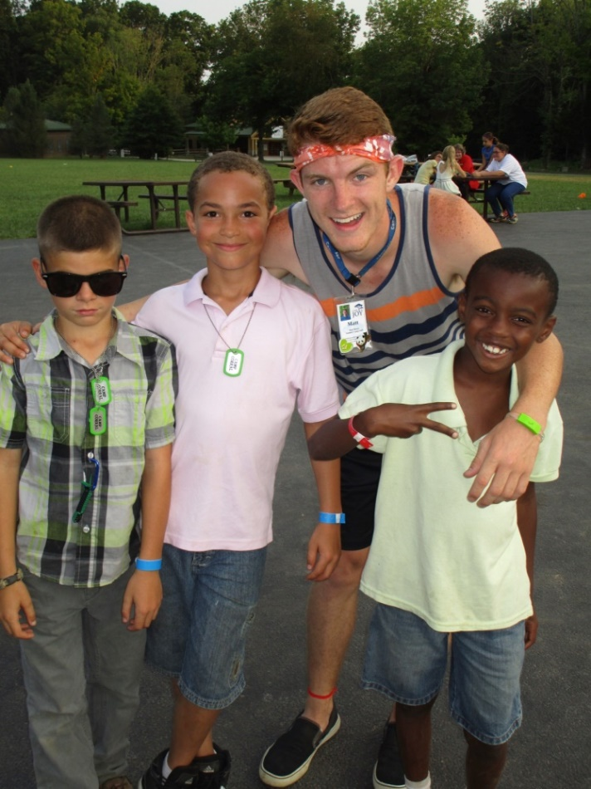
Camp Joy campers are living proof that environmental compassion starts young
The Sustainability of Your Donation
Counselor in Training program
60% of staff are past campers
Students champion change
upon returning to school
Gray Middle School (KY) salad
bar w/ local vegetables
Notes:
An investment in childhood education isn’t something you see an immediate return on, but it is still most definitely worth it

Slide 13
Thank You!

